Slide 1
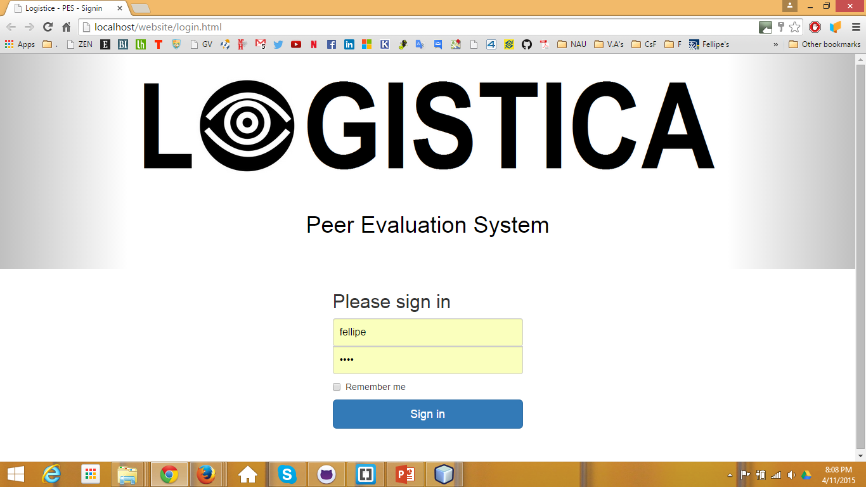
“fellipe” a supervisor

Slide 2
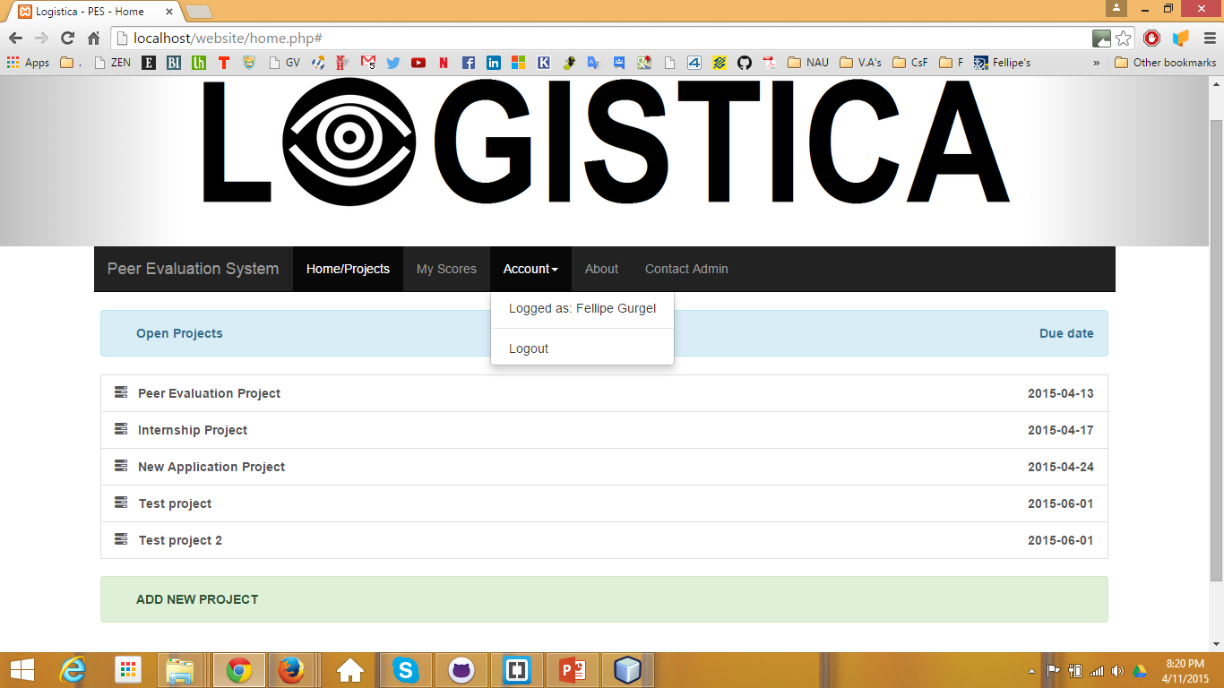
We can only see the projects for now. After we fix how to add employees to the projects (into the DB and through the form), we will be able to click on the project and see a list of the employees in it.
Only the supervisor can see this

Slide 3
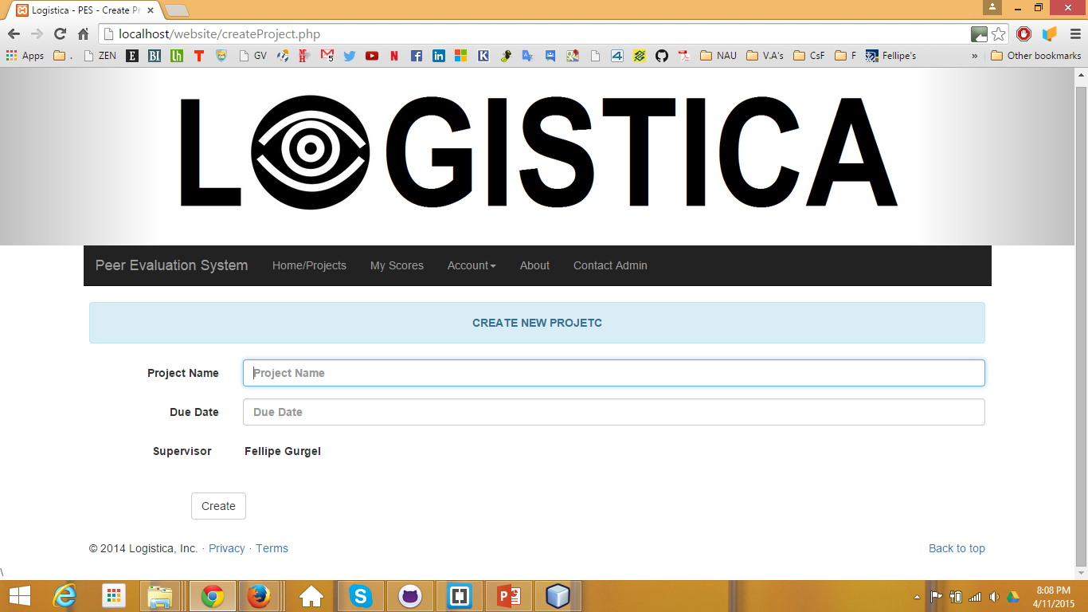
Need to add the option the insert the employees participating in the project

Slide 4
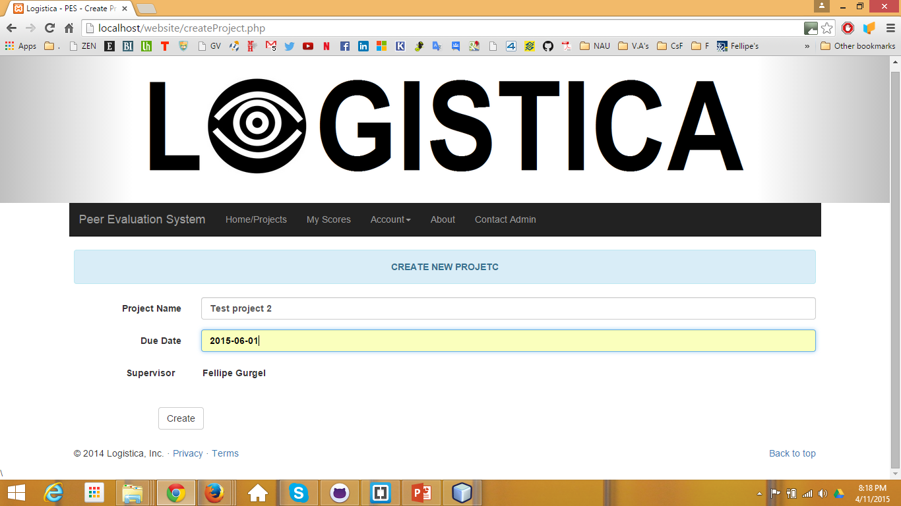

Slide 5
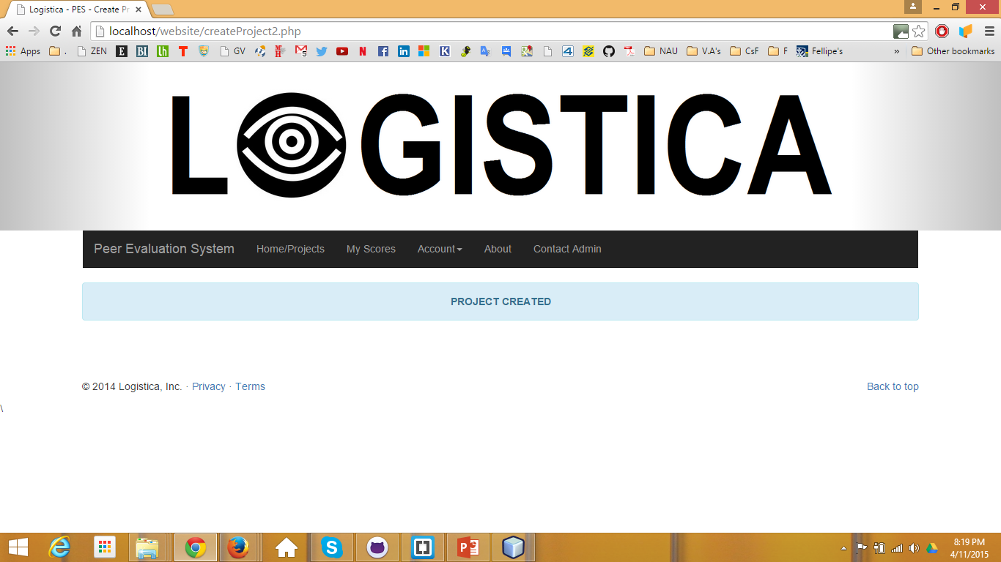

Slide 6
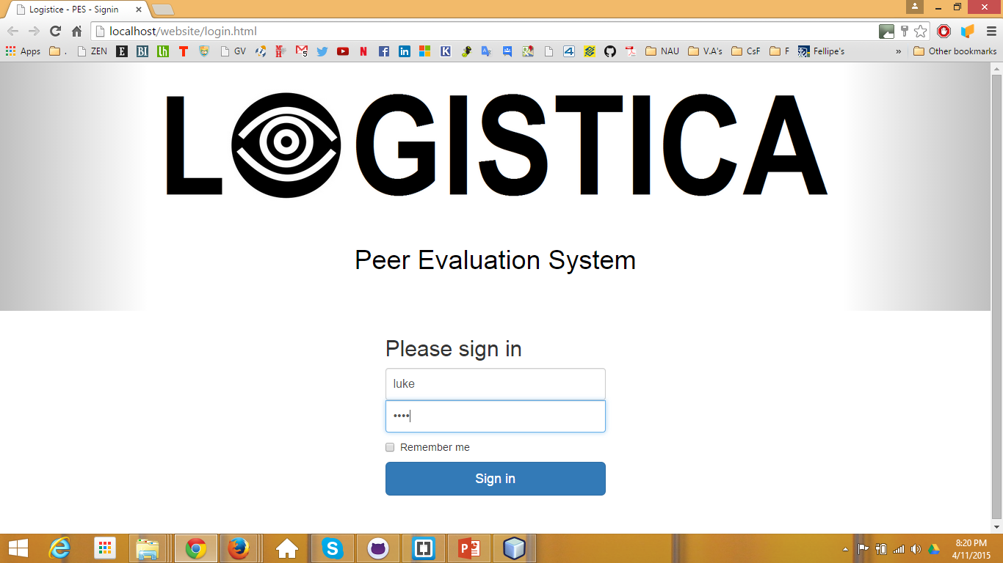
“Luke” is an admin

Slide 7
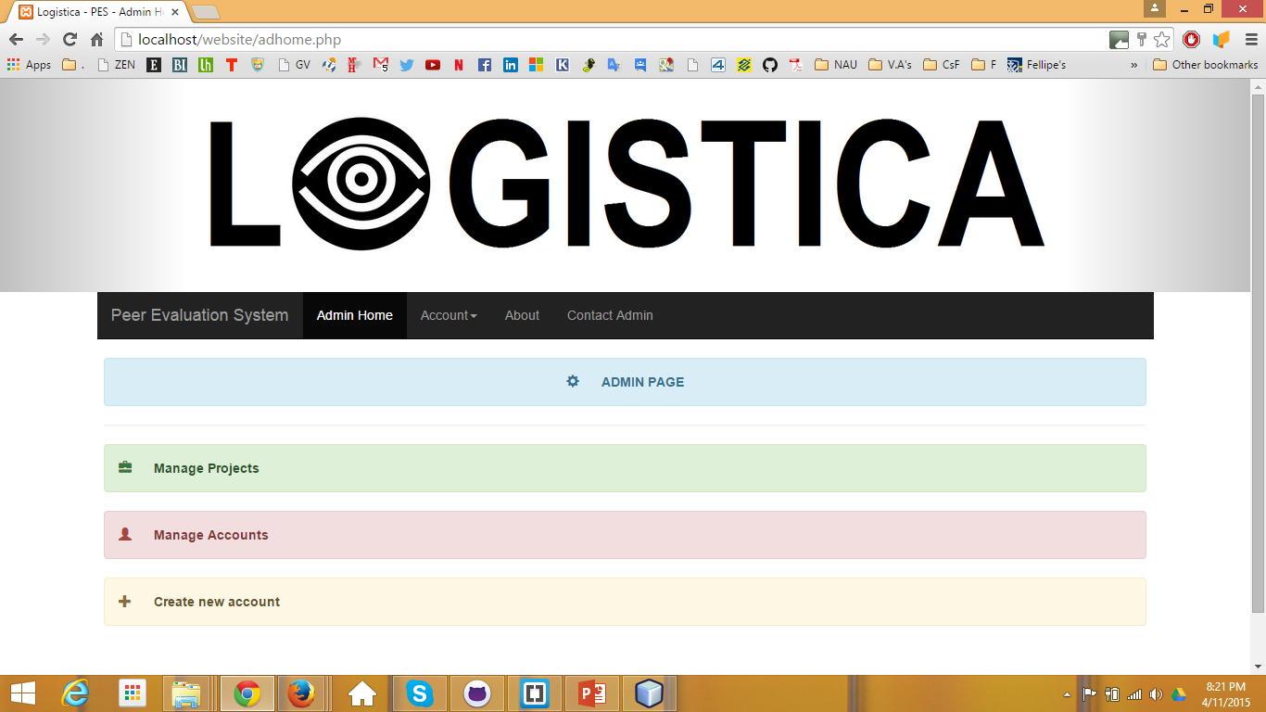

Slide 8
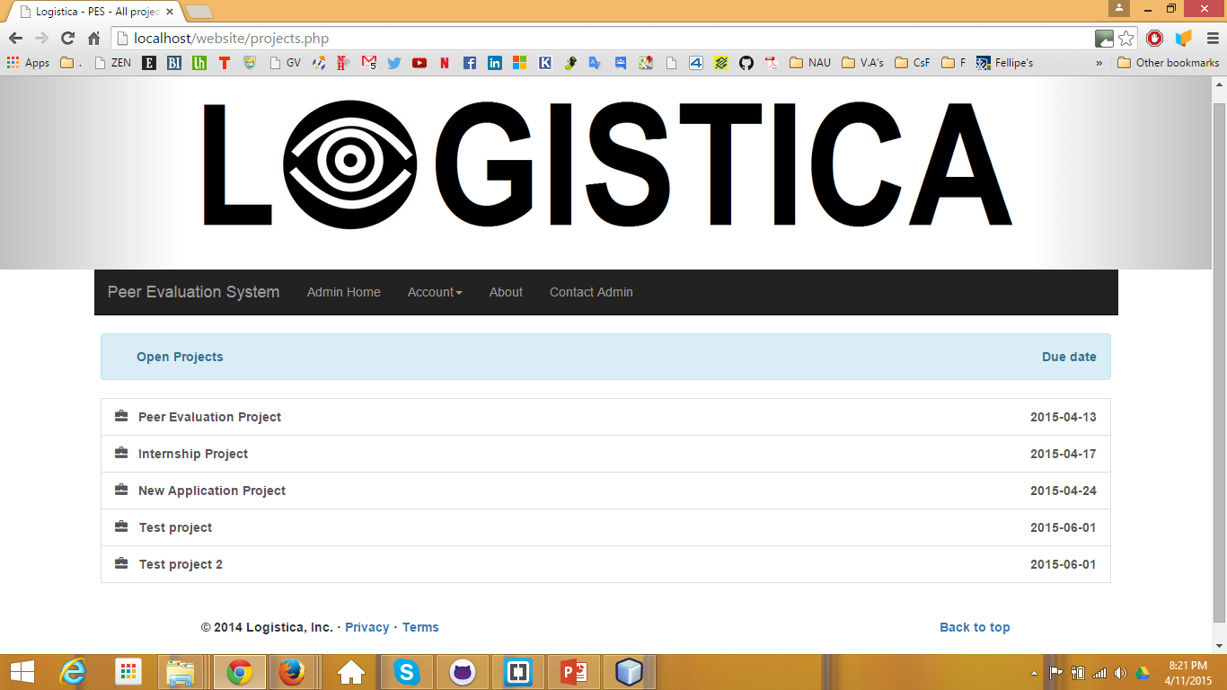
I clicked on “Manage Projects”
Missing: after click in a name, go a editable profile

Slide 9
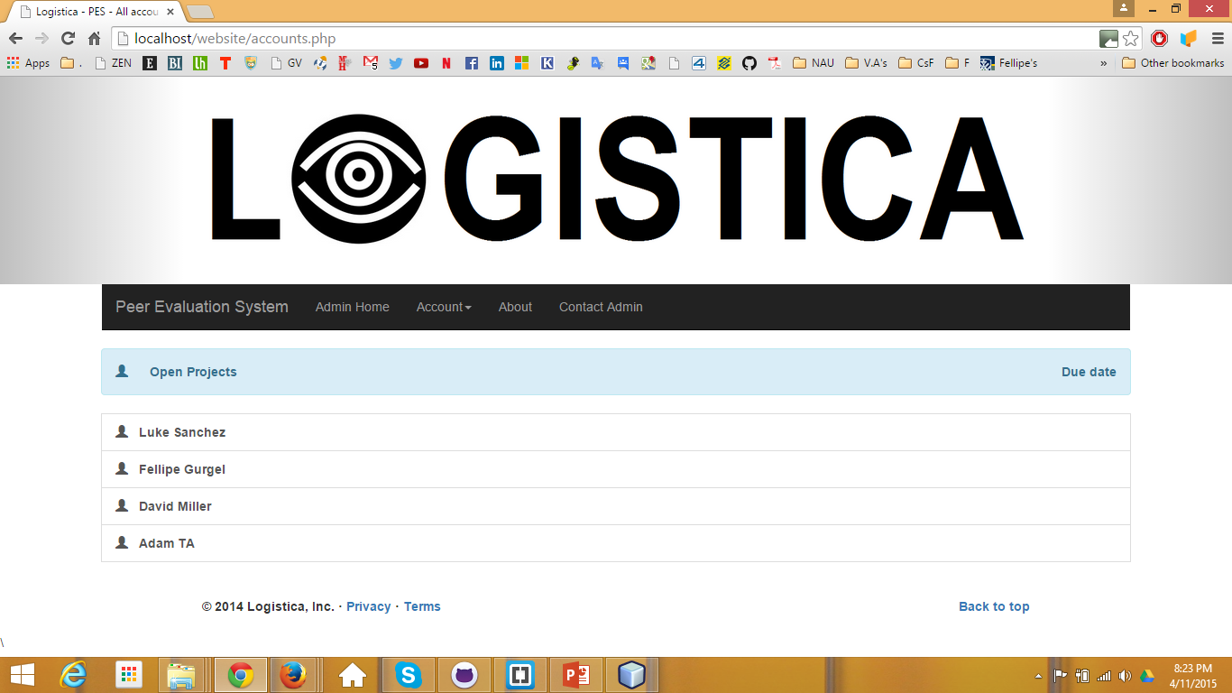
I clicked on “Manage Accounts”
Missing: after click in a name, go a editable profile

Slide 10
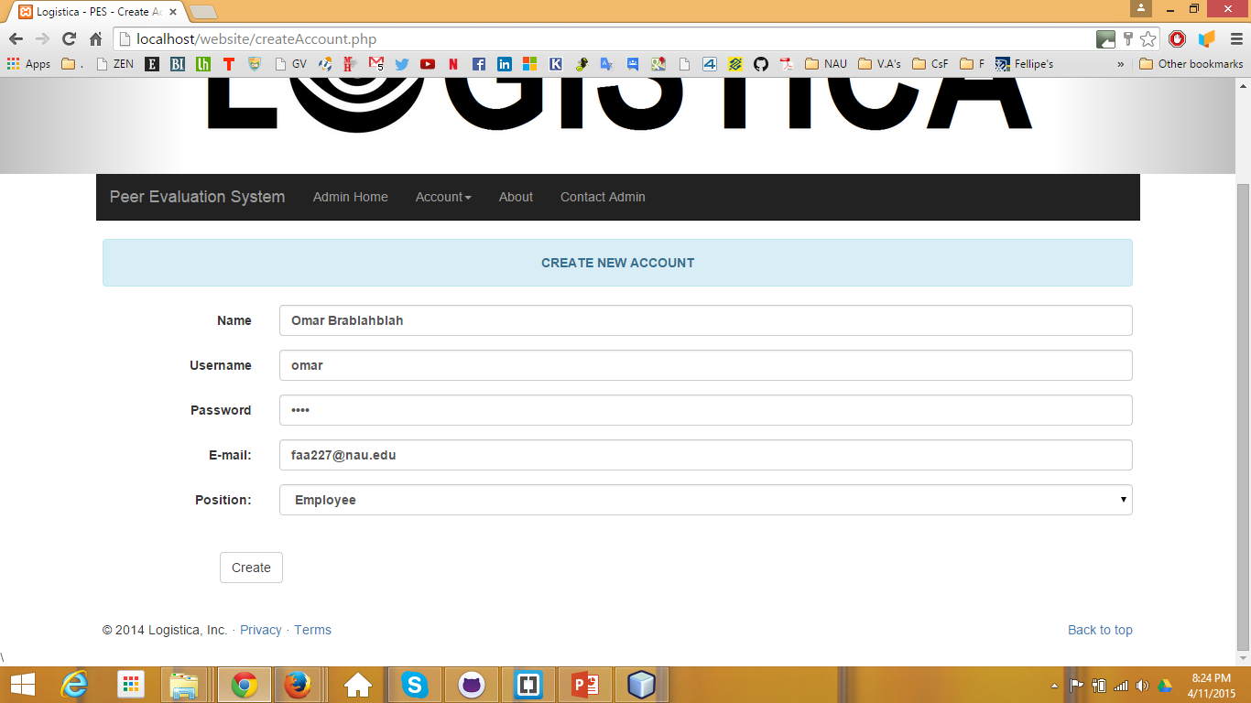
I clicked on “Create new Account”

Slide 11


